Slide 1
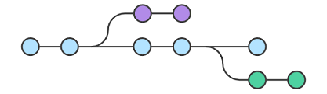
Branching and Tagging
Internal Only

Slide 2
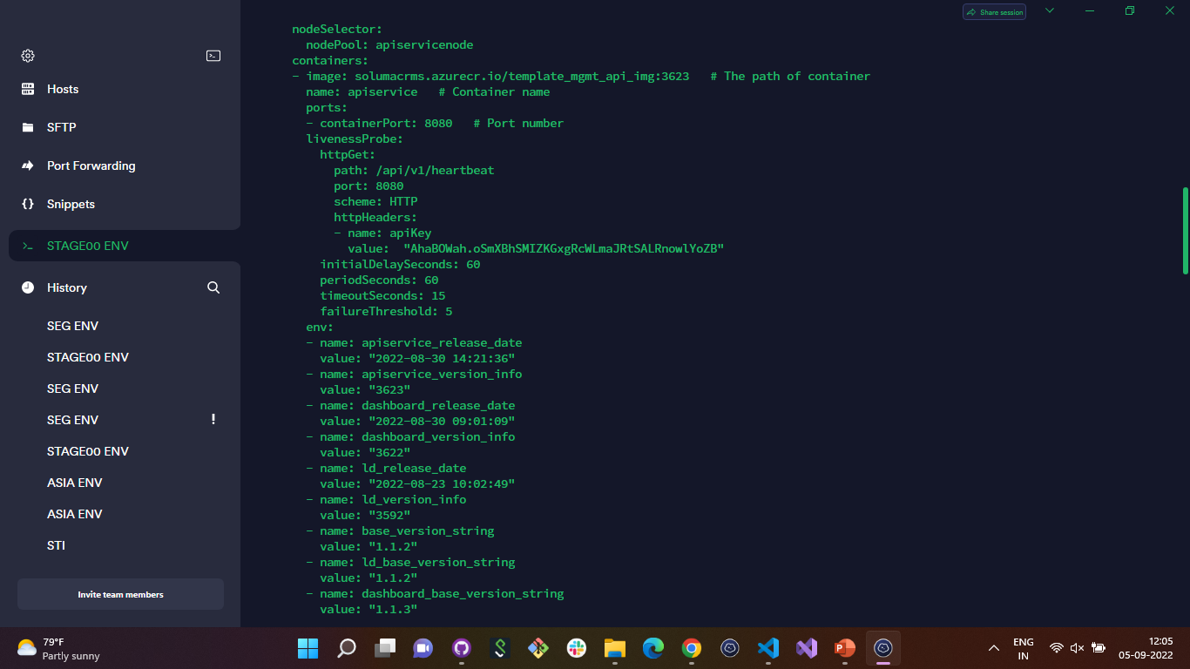
API Service YAML File

Slide 3
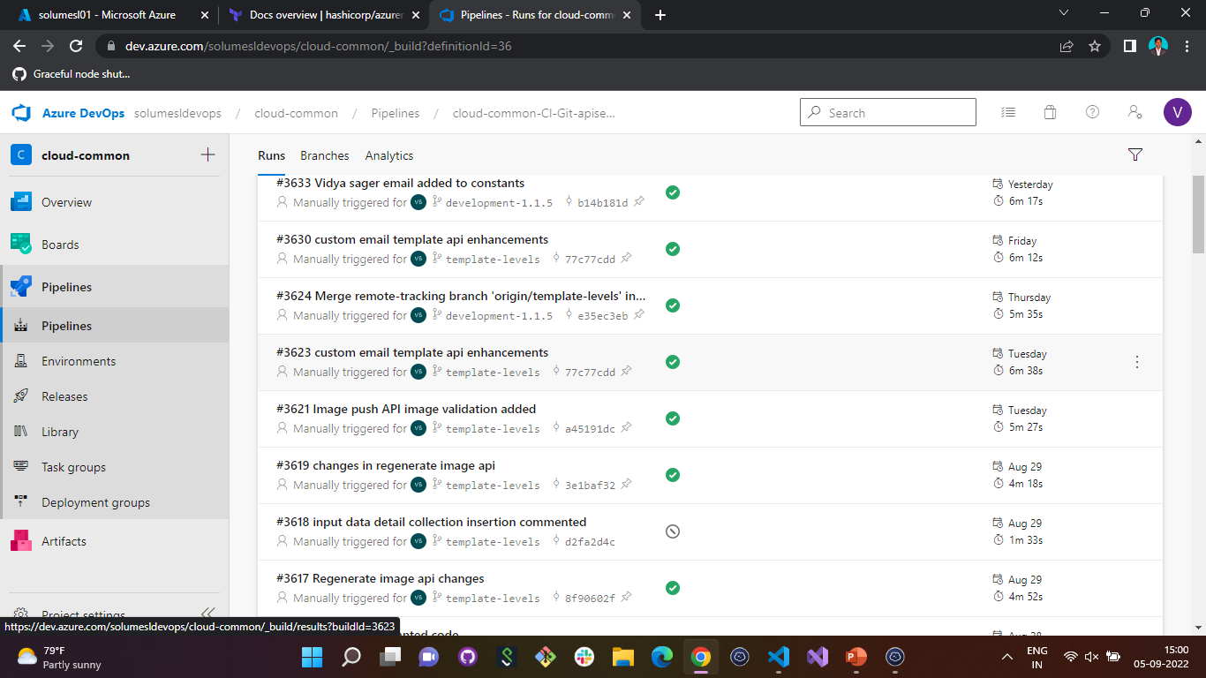
Azure Pipeline for API Service

Slide 4
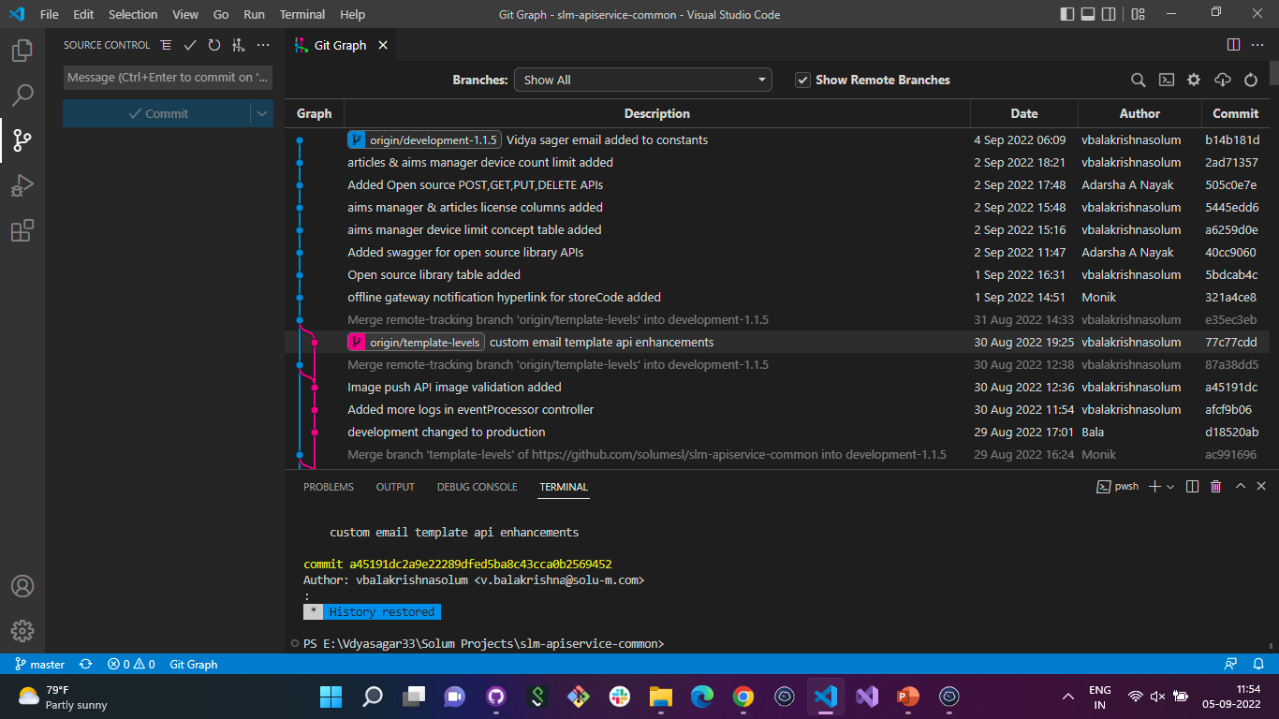
API Service Commits without Tags

Slide 5
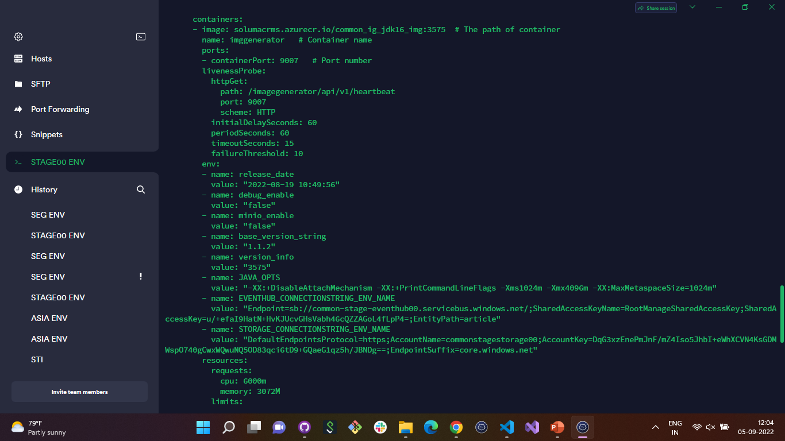
Image Generator YAML File

Slide 6
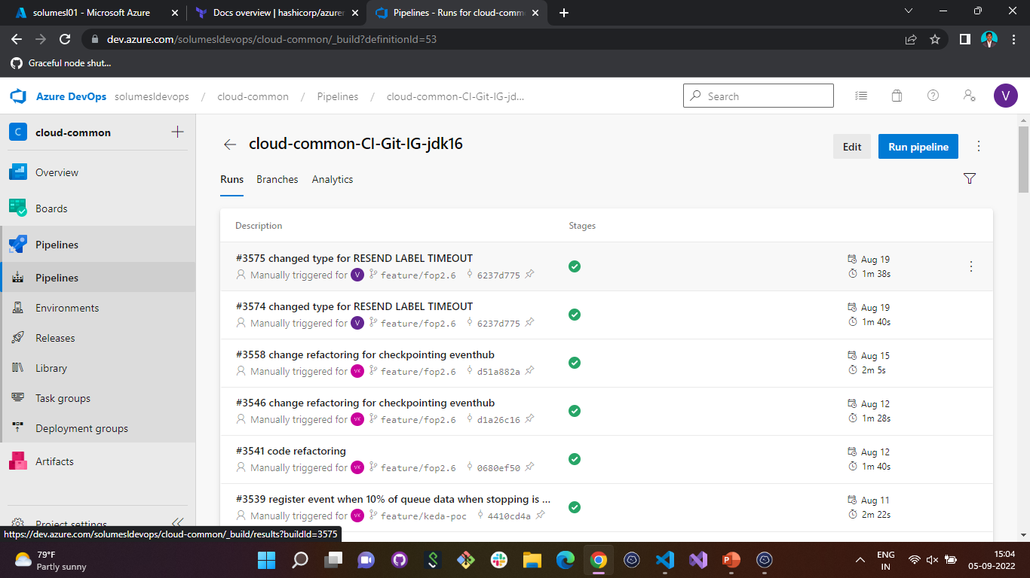
Azure Pipeline for Image Generator

Slide 7
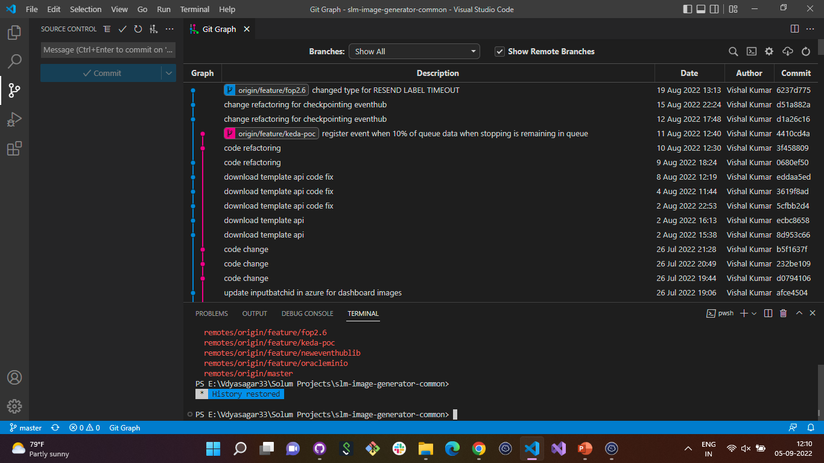
Image Generator Commits without Tags

Slide 8
API Service Commits without Tags

Slide 9
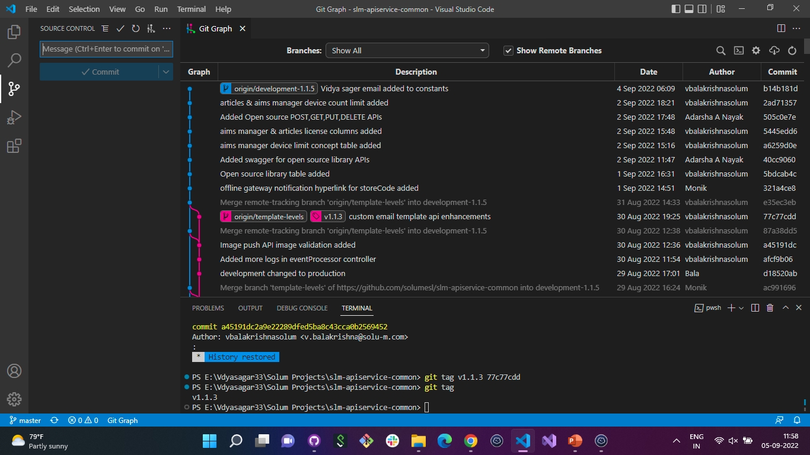
API Service Commits with Tags

Slide 10
Image Generator Commits without Tags

Slide 11
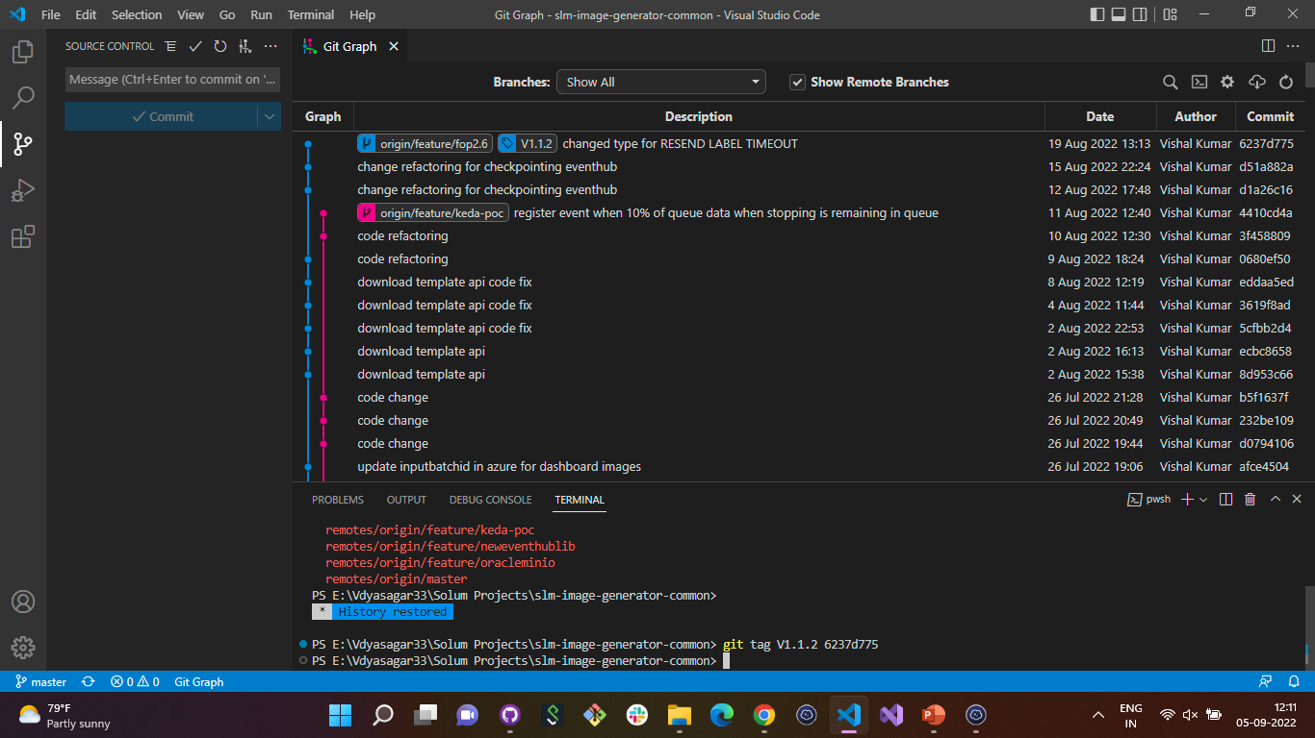
Image Generator Commits with Tags

Slide 12
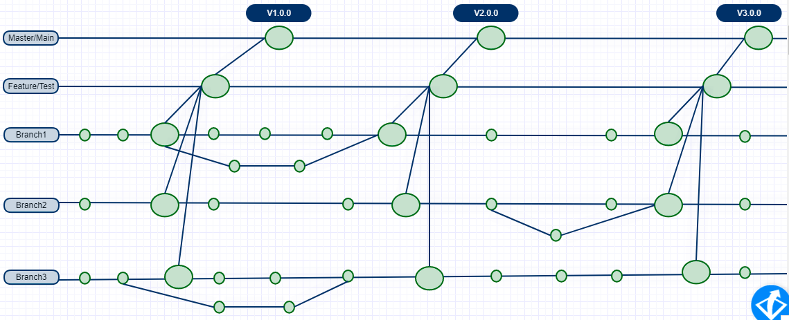
Sample Branching and Tagging Strategy

Slide 13

Suggestions

